Slide 1
Build an artificial neural network by implementing the backpropagation algorithm and test the same using appropriate datasets.
ML Practical – 9 A

Slide 2
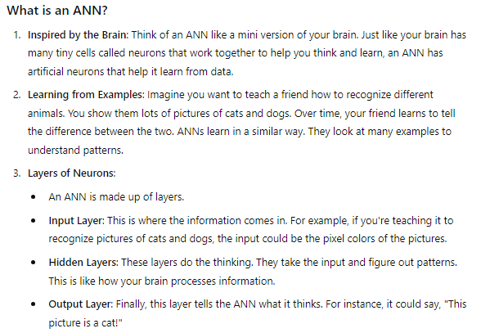

Slide 3
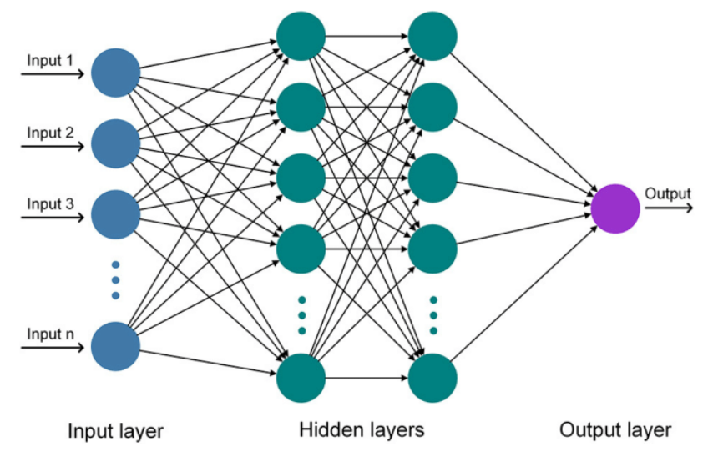

Slide 4
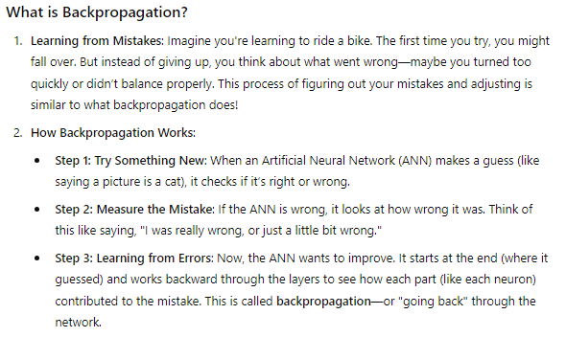

Slide 5
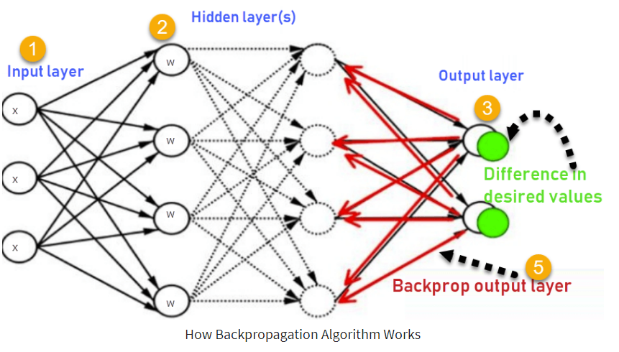
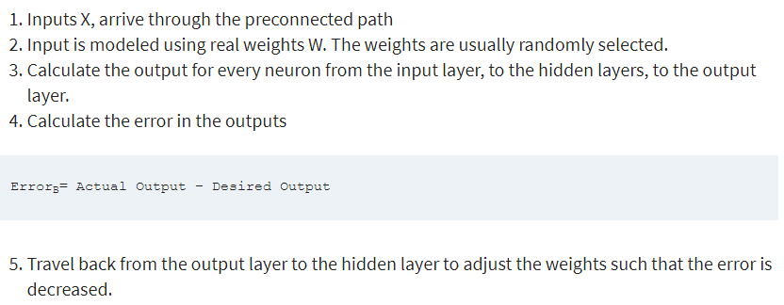

Slide 6
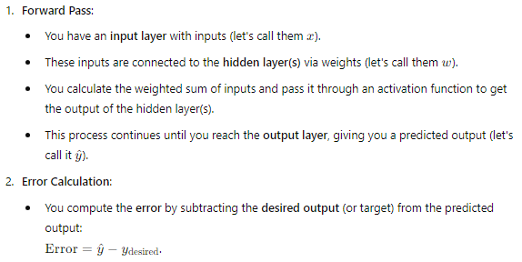

Key Points:
Forward pass: Calculate outputs and the error.
Backward pass: Use the error to adjust weights.
This process is repeated until the error becomes sufficiently small.

Slide 7






Now coming to practical:-

Slide 8



Slide 9

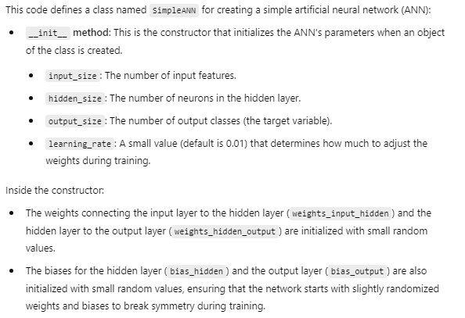

Slide 10
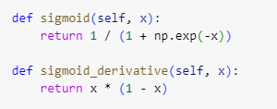
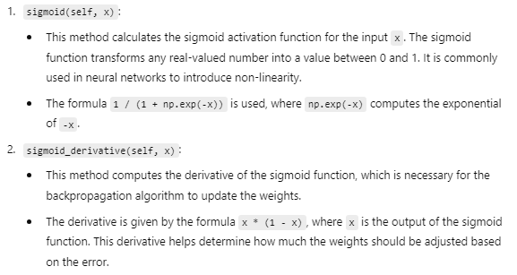

Slide 11


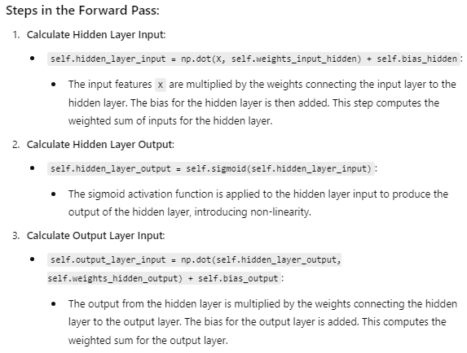
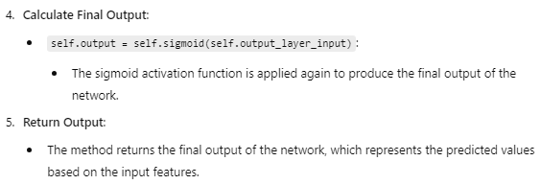

Slide 12
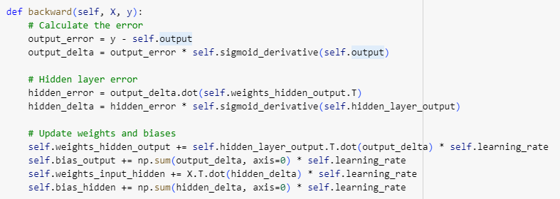
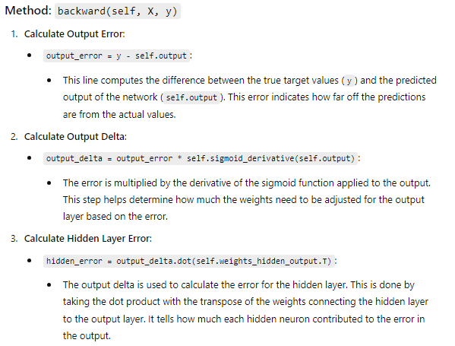


Slide 13
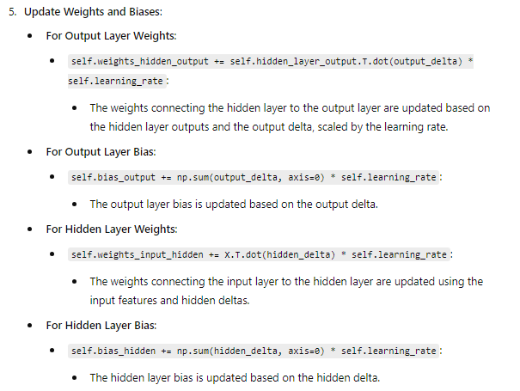
The backward pass calculates how much each weight and bias should be adjusted to reduce the error, thereby improving the model's predictions during training. This process is a crucial part of the backpropagation algorithm in neural networks.

Slide 14
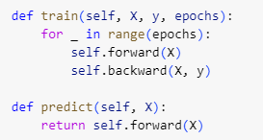
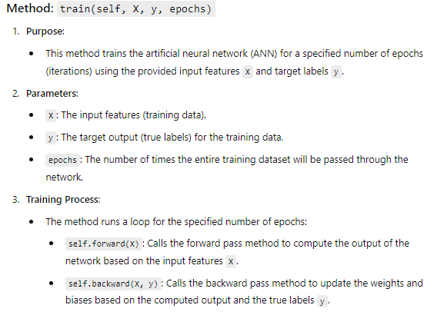
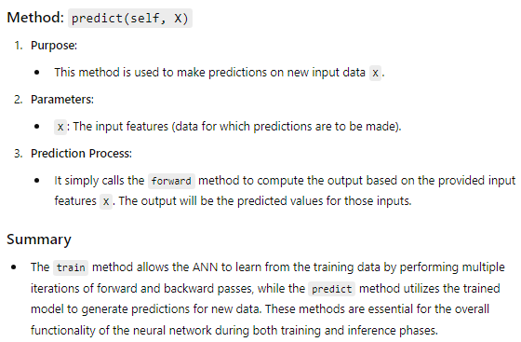

Slide 15

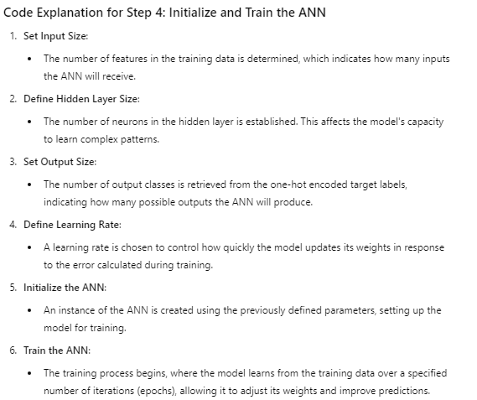

Slide 16
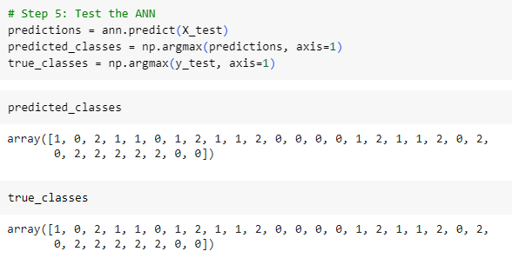
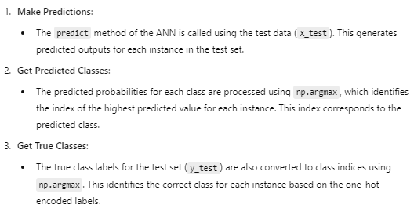

Slide 17
Assuming a set of documents that need to be classified, use the Naive Bayesian classifier model to perform this task.
ML Practical – 9 B

Slide 18


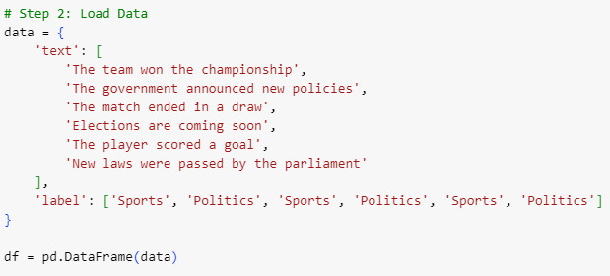


Slide 19



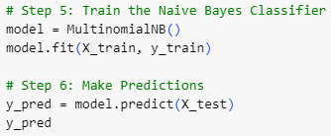


Slide 20
